Slide 1



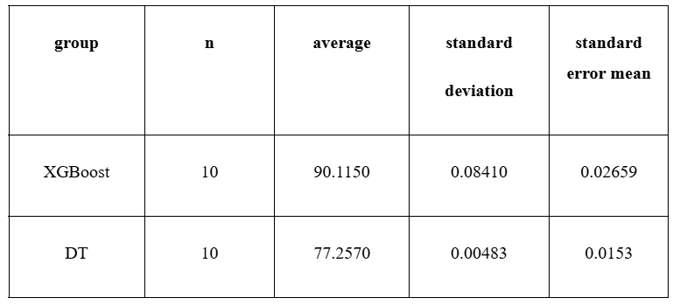
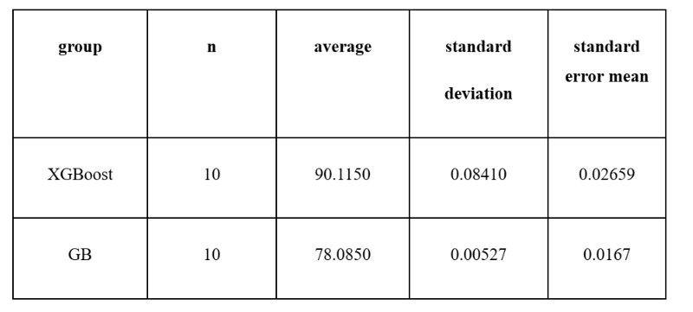
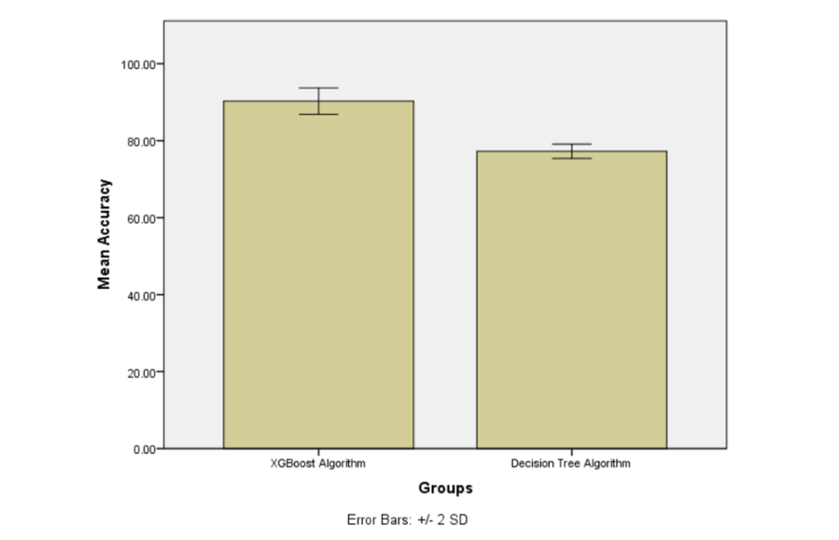
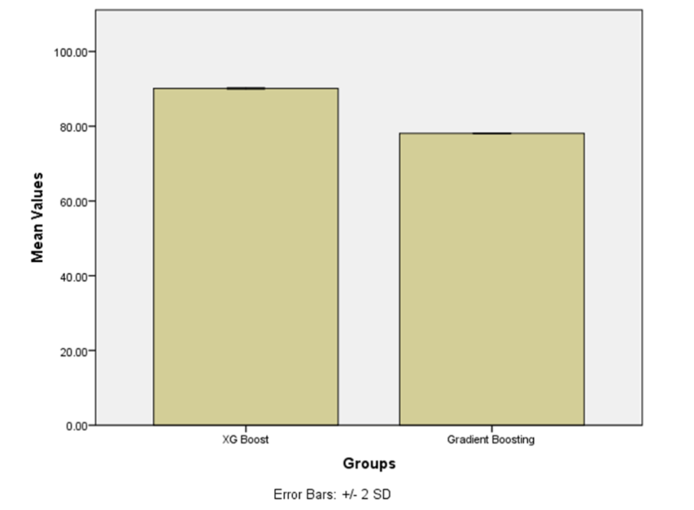


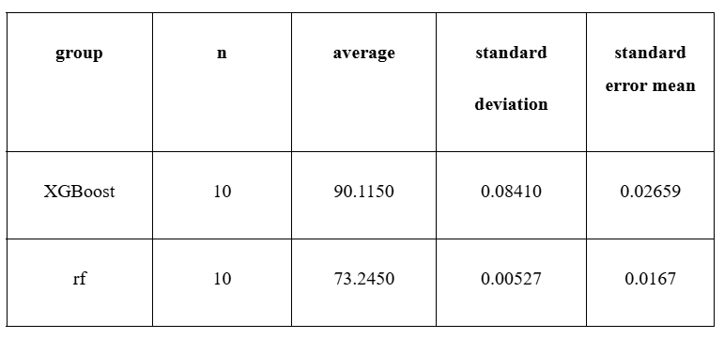
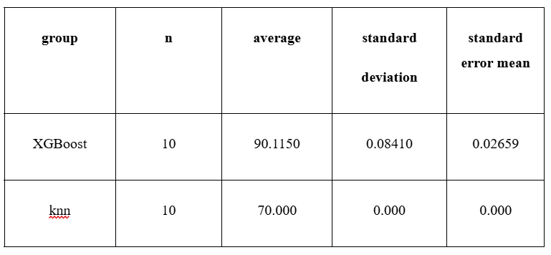
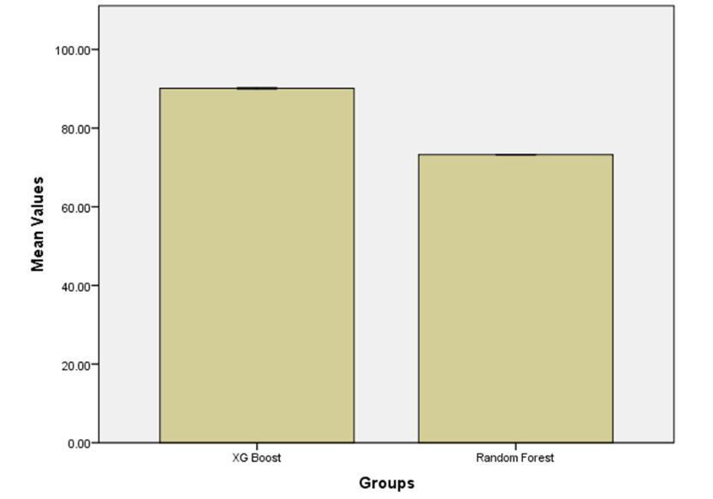
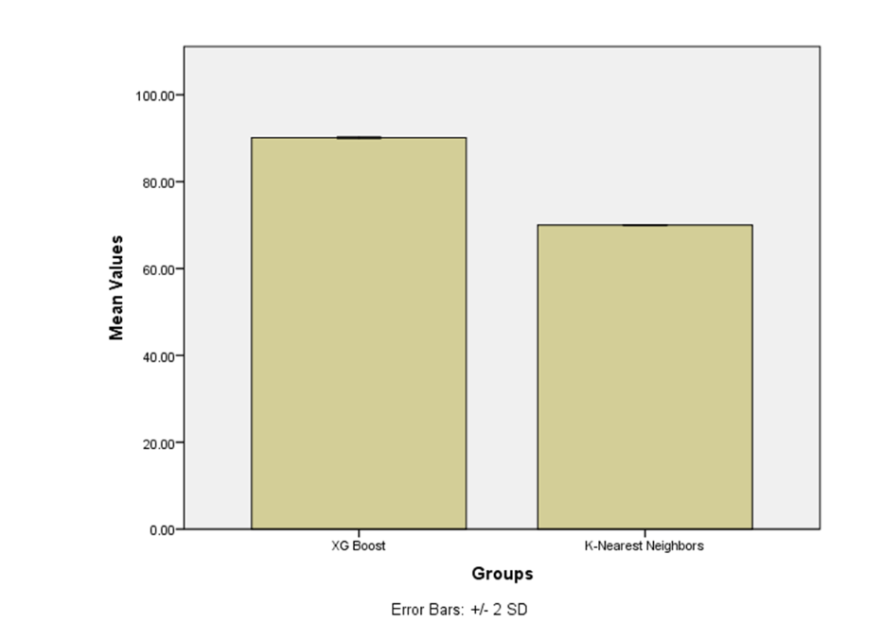
Students Name: JONNALAGADDA SAI CHANDU
Register No: 192211216
Guided By Dr. V. Balasubramani
Efficient Prediction of Accuracy in Inflation Rate Using Extreme Gradient Boosting Algorithm in Comparison with Decision Tree Algorithm
Enhanced Accuracy Prediction in Inflation Rate Using Extreme Gradient Boosting Algorithm in Comparison with Gradient Boosting Algorithm
INTRODUCTION
INTRODUCTION
This Research aims to enhance the Accuracy of Inflation Rate Prediction Using Extreme Gradient Boosting Algorithm in comparison with Decision Tree Algorithm
In the economic and financial sectors, one of the key challenges is the lack of precise and reliable forecasts for inflation rates, which are critical for policy formulation, investment decisions, and financial planning
This study focuses on improving the precision of inflation rate forecasting by evaluating and comparing the performance of two advanced machine learning techniques: Extreme Gradient Boosting (XG-Boost) and the Gradient Boosting Algorithm (GB).
Traditional forecasting methods often struggle with nonlinear patterns and high-dimensional data.
Inflation Decline
Rising Prices & Decreasing stability
MATERIALS AND METHODS
Models training (XG-Boost and DT)
MATERIALS AND METHODS
Text here
Data Collection
Data
Pre-processing
Splitting data into training and testing data
Data Collection
Data
Pre-processing
Splitting data into training and testing data
Models training (XG-Boost and DT)
Performance comparison of XG-Boost with DT
Model validation
Performance comparison of XG-Boost with GB
Model validation
RESULTS
RESULTS
When it came to forecasting inflation rates, the XG-Boost (extreme gradient booster) algorithm outperformed the Decision Tree method in terms of accuracy. The accuracy of the Decision Tree method was 77.25%, whereas XG-Boost's precision was 90.11%. In every iteration, XG-Boost consistently performed better than the Decision Tree model
When it came to predicting inflation rates, the XG-Boost (extreme gradient boosting) algorithm outperformed the Gradient Boosting method with an accuracy of 90.11%, whereas the latter method only managed 78.08%.
Groups statistics Between XG-Boost & DT
Groups statistics Between XG-Boost & GB
Accuracy Comparison Graph between XG-Boost & DT
Accuracy Comparison Graph between XG-Boost & GB
DISCUSSION AND CONCLUSION
DISCUSSION AND CONCLUSION
According to this study, the XG-Boost (extreme gradient booster) algorithm performs noticeably better than the Decision Tree method in terms of more accurate inflation rate prediction.
The Decision Tree algorithm's precision was just 77.25%, but XG-Boost's was 90.11%. The findings show that XG-Boost's capacity to successfully minimize bias and variance leads in a prediction model that is more stable and dependable.
According to this study, the XG-Boost (extreme gradient booster) algorithm performs better than the Gradient Boosting approach in terms of more accurate inflation rate predictions.
The accuracy of the Gradient Boosting technique was just 78.08%, whereas XG-Boost's precision was 90.11%. The findings show that XG-Boost offers a more accurate and dependable method of predicting inflation trends.
BIBLIOGRAPHY
BIBLIOGRAPHY
Beer, Christian, Robert Ferstl, and Bernhard Graf. 2025. “Improving Disaggregated Short-Term Food Inflation Forecasts with Webscraped Data.” 262. Working Paper.
Vilenko, Maya. 2025. “BiHRNN -- Bi-Directional Hierarchical Recurrent Neural Network for Inflation Forecasting.” http://arxiv.org/abs/2503.01893.
Huang, Naijing, Yuqing Qi, and Jie Xia. 2024. “China’s Inflation Forecasting in a Data-Rich Environment: Based on Machine Learning Algorithms.” Applied Economics, March. https://doi.org/10.1080/00036846.2024.2322572.
Sun, Lu, Zhixiang Yin, and Lin Lu. 2025. “ISLRWR: A Network Diffusion Algorithm for Drug-Target Interactions Prediction.” PloS One 20 (1): e0302281.
Vilenko, Maya. 2025. “BiHRNN -- Bi-Directional Hierarchical Recurrent Neural Network for Inflation Forecasting.” http://arxiv.org/abs/2503.01893.
Somakumar, Shwetha, Fathima Thashreefa Basheer, Vijayanarayana K, Vani Lakshmi R, Shyamasunder N. Bhat, Gabriel Sunil Rodrigues, Girish Menon R, Elstin Anbu Raj S, and Rajesh V. 2025.
Prediction of Accuracy in Inflation Rate Using Extreme Gradient Boosting Algorithm in Comparison with Random Forest Algorithm
Advanced Accuracy Prediction in Inflation Rate Using Extreme Gradient Boosting Algorithm in Comparison with K-Nearest Neighbors Algorithm
INTRODUCTION
INTRODUCTION
This research investigates the potential of machine learning models to enhance the accuracy of inflation rate forecasting, specifically comparing the performance of the Extreme Gradient Boosting (XGBoost) algorithm with the Random Forest (RF) algorithm.
Random Forest is an ensemble learning technique that constructs multiple decision trees and aggregates their predictions, making it robust to overfitting and effective .
This research explores the use of machine learning techniques to improve the accuracy of inflation rate prediction, focusing on a comparative analysis between the Extreme Gradient Boosting (XGBoost) algorithm and the K-Nearest Neighbors (KNN) algorithm.
Extreme Gradient Boosting, in contrast, builds models iteratively, where each new tree corrects the errors of the previous ones.
Market Tremors
Dollar`s Decent: shrinking purchasing power
MATERIALS AND METHODS
Models training (XG-Boost and DT)
MATERIALS AND METHODS
Models training (XG-Boost and DT)
Data Collection
Data
Pre-processing
Splitting data into training and testing data
Data Collection
Data
Pre-processing
Splitting data into training and testing data
Performance comparison of XG-Boost with RF
Model validation
Performance comparison of XG-Boost with KNN
Model validation
RESULTS
RESULTS
With a precision of 90.11% as opposed to Random Forest's 73.24%, the comparison research showed that XG-Boost fared better than Random Forest in forecasting inflation rates.XG-Boost consistently outperformed all test iterations,
The investigation showed that when it came to predicting inflation rates, XG-Boost performed noticeably better than KNN. KNN had a significantly lower accuracy of 70.00%, whilst XG-Boost attained an accuracy of 90.11%.
Groups statistics Between XG-Boost & RF
Groups statistics Between XG-Boost & KNN
Accuracy Comparison Graph between XG-Boost & RF
Accuracy Comparison Graph between XG-Boost & KNN
DISCUSSION AND CONCLUSION
DISCUSSION AND CONCLUSION
According to the study's findings, XG-Boost predicts inflation rates better than the Random Forest algorithm. Random Forest's accuracy was 78.08%
whereas XG-Boost's precision was 90.11%. These findings suggest that XG-Boost provides a more accurate and dependable way to predict inflation trends.
So, we conclude that XG-Boost outperforms random forest algorithm in terms of inflation rate prediction
According to the study's findings, XGBoost predicts inflation rates more accurately than the KNN algorithm. KNN trailed behind with an accuracy of 70.00%
whereas XGBoost obtained a greater accuracy of 90.11%. These results demonstrate that the XGBoost represents a more precise and trustworthy forecasting method.
BIBLIOGRAPHY
BIBLIOGRAPHY
Beer, Christian, Robert Ferstl, and Bernhard Graf. 2025. “Improving Disaggregated Short-Term Food Inflation Forecasts with Webscraped Data.” 262. Working Paper. https://hdl.handle.net/10419/312869.
“Global Inflation Forecasting and Uncertainty Assessment: Comparing ARIMA with Advanced Machine Learning.” 2025. Journal of Radiation Research and Applied Sciences 18 (2): 101402.
Vilenko, Maya. 2025. “BiHRNN -- Bi-Directional Hierarchical Recurrent Neural Network for Inflation Forecasting.” http://arxiv.org/abs/2503.01893.
Beer, Christian, Robert Ferstl, and Bernhard Graf. 2025. “Improving Disaggregated Short-Term Food Inflation Forecasts with Webscraped Data.” 262. Working Paper.
Vilenko, Maya. 2025. “BiHRNN -- Bi-Directional Hierarchical Recurrent Neural Network for Inflation Forecasting.” http://arxiv.org/abs/2503.01893.
“Global Inflation Forecasting and Uncertainty Assessment: Comparing ARIMA with Advanced Machine Learning.” 2025. Journal of Radiation Research and Applied Sciences 18 (2): 101402.
Text here

